Slide 1
Development of master curricula for natural disasters risk management in Western Balkan countries
WP1 – Analysis of natural disasters needed to be managed in Western Balkan region
DI Kurt Glock
University of Natural Resources and Life Sciences BOKU, Vienna
Kick-off meeting / 16th December 2016
Project number: 573806-EPP-1-2016-1-RS-EPPKA2-CBHE-JP
"This project has been funded with support from the European Commission. This publication reflects the views only of the author, and the Commission cannot be held responsible for any use which may be made of the information contained therein"

Slide 2
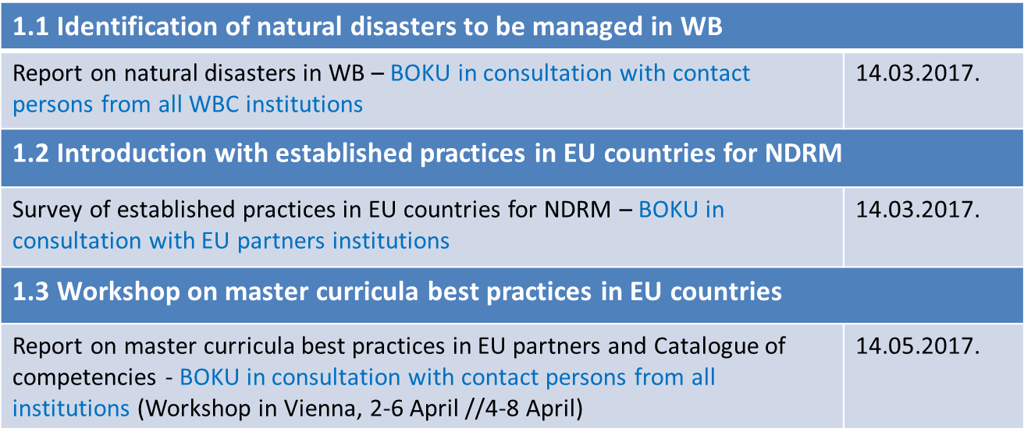
WP1 – to do list Analysis of natural disasters needed to be managed in Western Balkan region
Development of master curricula for natural disasters risk management in Western Balkan countries

Slide 3
WP 1.1 – Identification of natural disasters
Development of master curricula for natural disasters risk management in Western Balkan countries

Slide 4
WP 1.1 – Identification of natural disasters
Development of master curricula for natural disasters risk management in Western Balkan countries

Slide 5
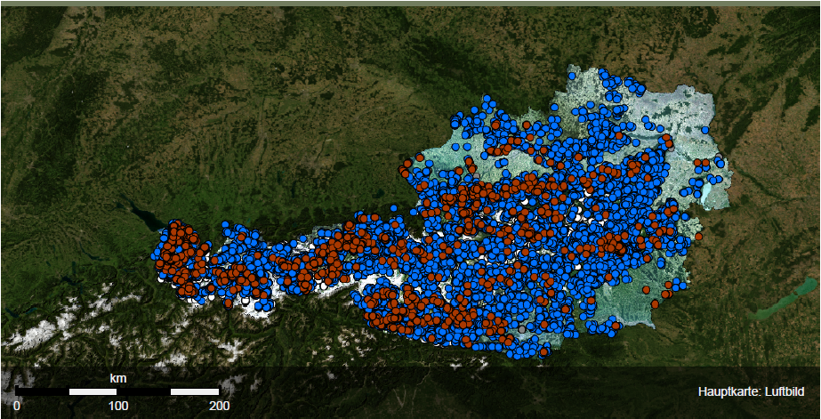
WP 1.1 – Identification of natural disasters
Development of master curricula for natural disasters risk management in Western Balkan countries
Floods
Landslides
Rockfalls
Avalanches
(www.naturgefahren.at, 2016)

Slide 6
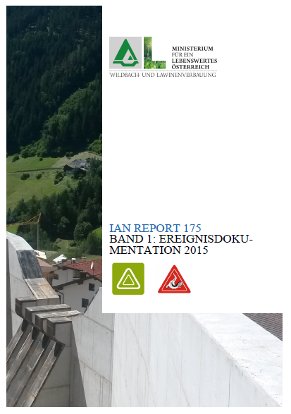
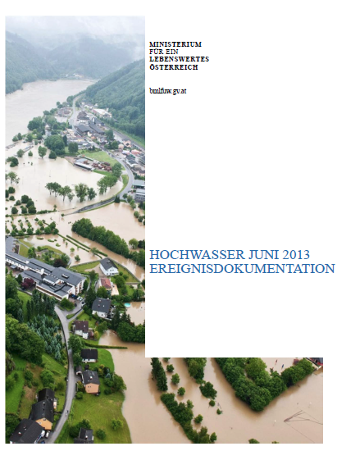
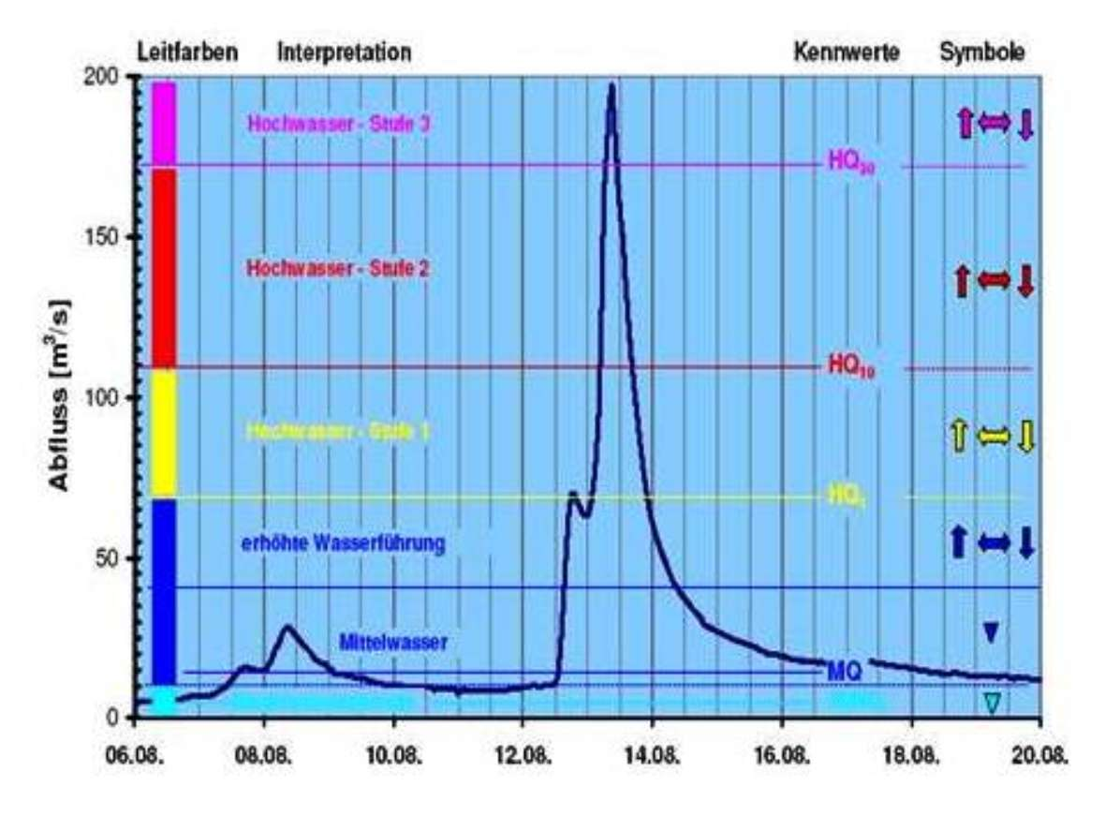
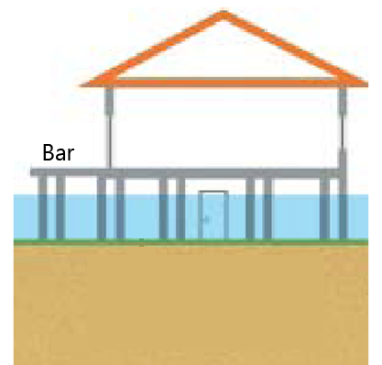
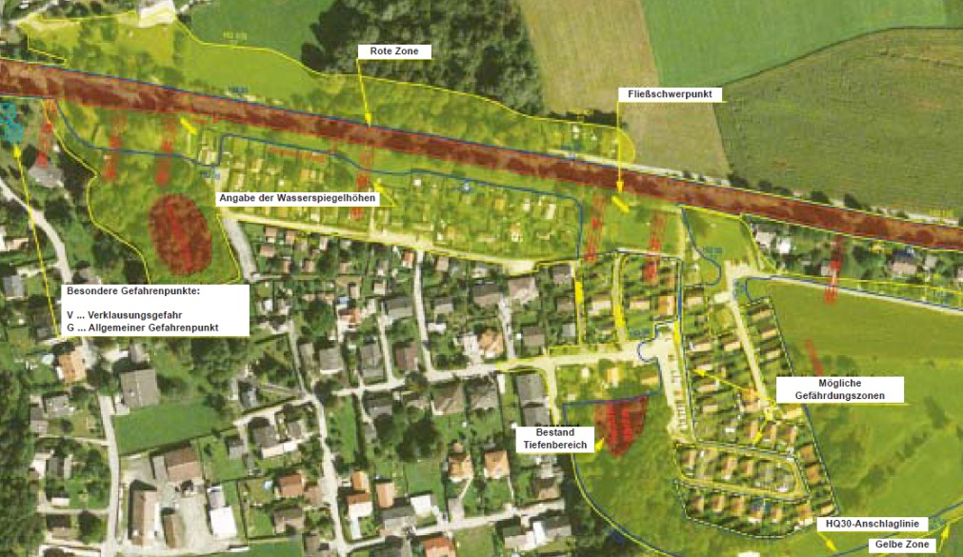
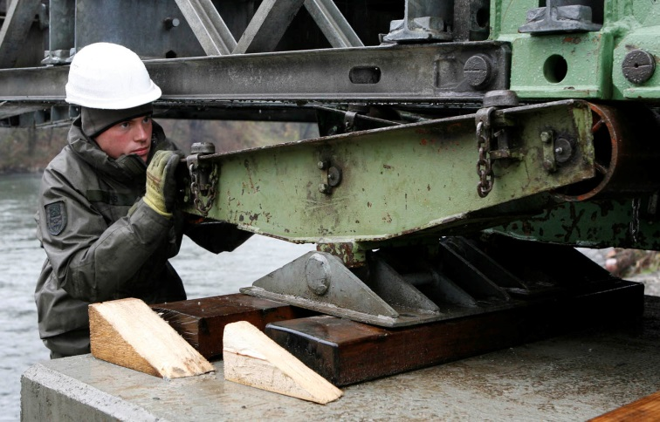
WP 1.2 – Established practices for natural disaster risk management in Austria
Development of master curricula for natural disasters risk management in Western Balkan countries
BMLFUW, 2007
Bundesheer, Moser, 2009
(BMLFUW, 2004)

Slide 7
WP 1.3 – Master curricula in Austria
Development of master curricula for natural disasters risk management in Western Balkan countries
Master „Alpine Natural Hazards / Torrent- and Avalanche Control“ (ALPNAT)
Area of activities
evaluation and analysis of hazards and depositional processes in alpine regions
prevention of alpine natural hazards
integrative management of catchment areas
risk prevention
hazard/catastrophe management

Slide 8
WP1 – Invitation
Development of master curricula for natural disasters risk management in Western Balkan countries
1.1 Identification of natural disasters to be managed in WB
Cooperation between BOKU and all partners from Western Balkan Type of natural disasters Statistics Etc.
Please provide us INFOS!
1.2 Introduction with established practices in EU countries for NDRM
Cooperation between BOKU and all partners from EU Concepts and approaches Guidlines Etc.
1.3 Workshop on master curricula best practices in EU countries
Cooperation between BOKU and all partners Workshop on 4.-8. April 2017 in Vienna Introduction and analysis of existing master curricula Basics for WP2

Slide 9
Contact information
Development of master curricula for natural disasters risk management in Western Balkan countries
University of Natural Resources and Life Sciences Vienna (BOKU)
Department of Water, Atmosphere and Environment (WAU)
Institute of Water Management, Hydrology and Hydraulic Engineering (IWHW)
Find more about IWHW in
http://www.wau.boku.ac.at/en/iwhw/
Kurt Glock
Dipl.-Ing.
E-mail: kurt.glock@boku.ac.at
Michael Tritthart
Priv.-Doz. Dipl.-Ing. Dr.techn.
E-mail: michael.tritthart@boku.ac.at

